Slide 1
05 | Controllers and Views
Susan Ibach | Developer Evangelist
Christopher Harrison | Content Developer

Slide 2
Module Overview
Using templates
Ensuring consistency
Forms

Slide 3
Using templates

Slide 4
How do I send back complex HTML?
Django supports templates for creating complex template
A template has a collection of placeholders for dynamic content

Slide 5
What are Django templates?
Inject custom code into HTML
Artist Details
Artist:
Year formed:
The Cure
1978

Slide 6
Template basics
Templates are essentially just HTML
Templates exist in a folder named templates
Has a code syntax similar to Python
But it's not actually Python

Slide 7
Template example
<html>
<head>
<title>{{ name }}</title>
</head>
<body>
<h1>{{ name }}</h1>
<div>{{ name }} formed in {{ year_formed }}</div>
</body>
</html>

Slide 8
Looping through collections
<ul>
{% for album in albums %}
<li>{{ album.name }}</li>
{% endfor %}
</ul>

Slide 9
How do I specify the use of a template
Use render_to_response
return render_to_response('template.html', {'variable_name':value});
First parameter is the name of the template
The second parameter is the collection of variables the template expects

Slide 10
Using a template

Slide 11
Forms

Slide 12
How do we submit data?
Data is of course submitted by using forms
You could, if you wanted to, create your forms manually
Additional work
Doesn't deal well with changes to the model

Slide 13
Can Django create forms for us?
As a matter of fact, it can!
(it'd have been silly to create a slide asking that if the answer was "no")

Slide 14
How can we create forms using Django
Create a form class
Bind a form class to a model

Slide 15
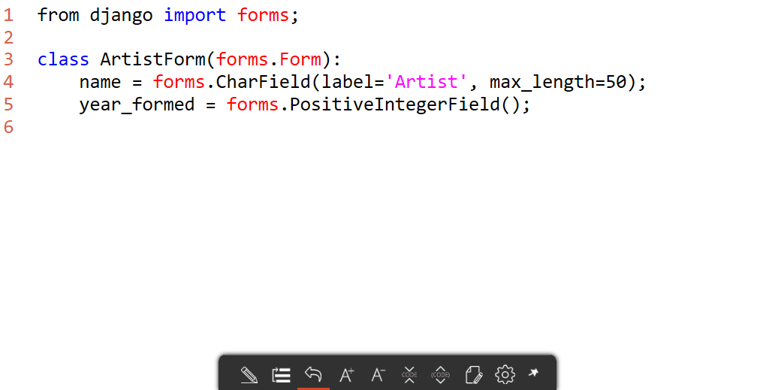
Form class

Slide 16
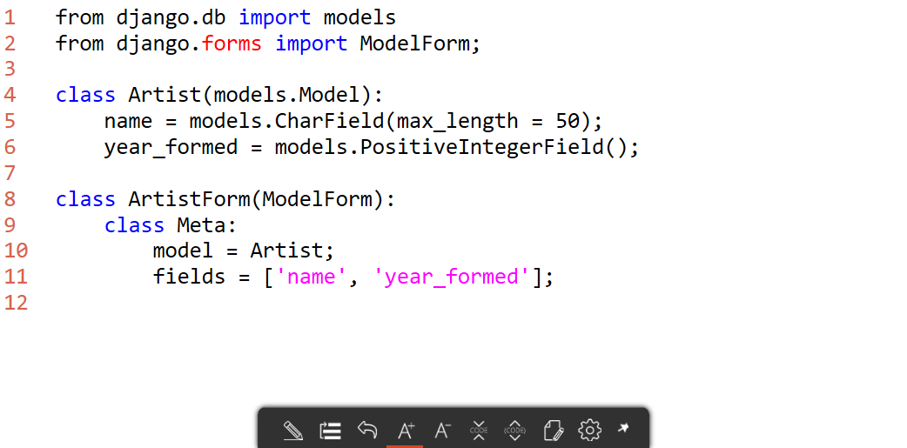
ModelForm

Slide 17
What's the advantage of binding the form to the model?
The form is automatically updated
The form has the ability to automatically validate data
You can save directly from the form

Slide 18
Creating a ModelForm

Slide 19
Creating the HTML
In order to create the form, you need an HTML page to "host" the form
It can be this simple:
<form method="post">
{% csrf_token %}
{{ form }}
<button type="submit">Save</button>
</form>

Slide 20
Controlling the form
By default, the form will be created as a table
{{ form.as_p }} will use <p> elements
{{ form.as_ul }} will use <li> elements
It is possible to grab the actual fields and completely customize the HTML as needed

Slide 21
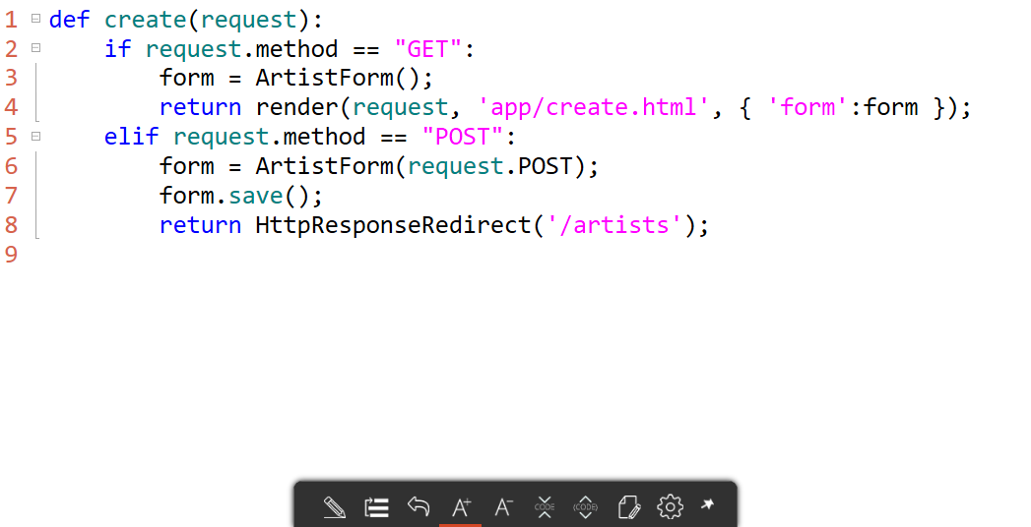
Using the form in the view

Slide 22
Creating a create form

